Slide 1
E - Commerce Purchase Data Analysis
M. Tech. – DSML → Team 7
Date: 12th Sep 2020
NPV – Project Presentation
PRAVEEN MANOHAR G
RAHUL A
RAJESH RAMACHANDER
RANJITH GNANA SUTHAKAR ALPHONSE RAJ
YASHASWI GURUMURTHY

Slide 2
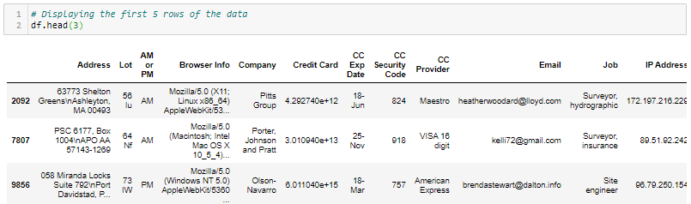
Project Overview & Process
Dataset Provided:
E-Commerce purchase data with Purchaser and Purchase details
Analysis Objective:
Characterize customer purchases from the E-commerce purchase data to identify patterns or trends for related insights
Analysis Steps/ Approach:
Initial exploration of the data set
Interpreting and transforming the data set
Imputing the data
Identify 5 key questions to be answered
Exploring & Analyzing the data
Learnings & Conclusions

Slide 3
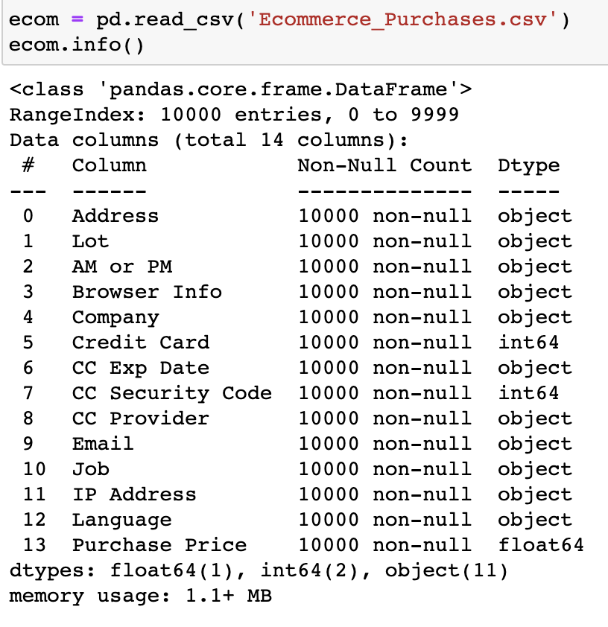
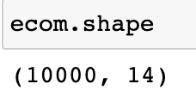
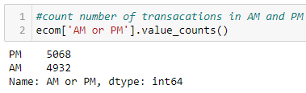
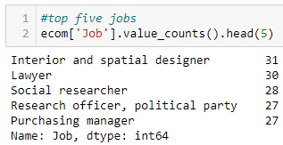
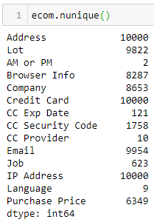
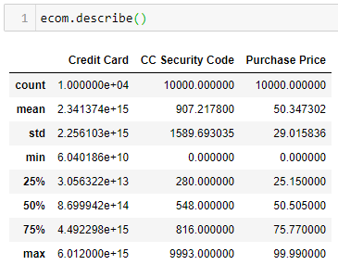
Initial exploration of the data set
E-Commerce purchase data with Purchaser and Purchase details
Data overview:
Shape:
Rows → 10000
Columns → 14
Data types:
Categorical → 12
Numerical → 3
‘Credit Card’ & ‘CC Security Code’ are NOT usable as Numerical
NO null values present
Count of unique data points per column:
Description of Numerical variables:

Slide 4



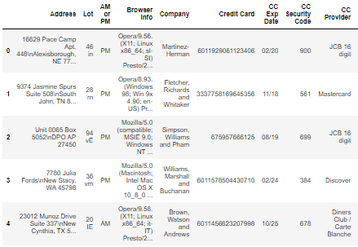
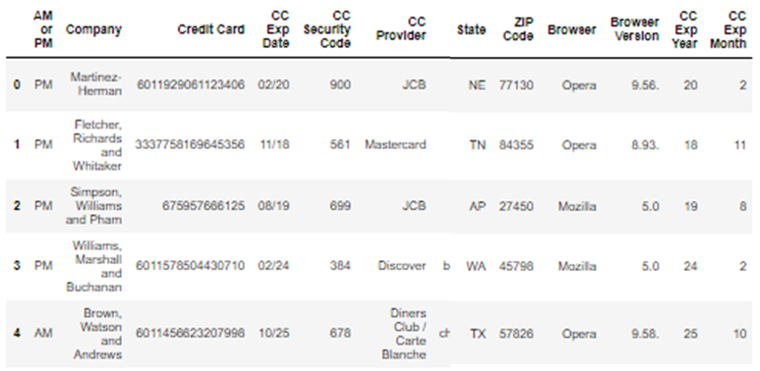
Interpreting and transforming the data set
Clean up ‘Address’ field to extract ‘State’ and ‘Zip Code’
Extract ‘Browser’ and ‘Browser Version’ from the ‘Brower Info’ field
Extract Credit card related features
Original Data set
Enriched Data set
Observations:
There are 10000 different Credit cards registered, and 10000 different IP addresses. Interestingly, email addresses are repeated
The data set contains NO duplicate records

Slide 5
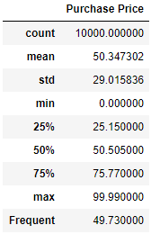
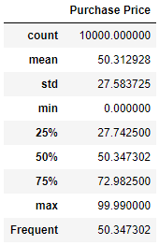
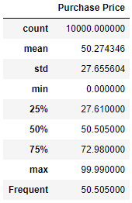
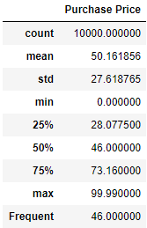
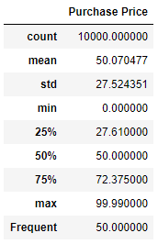
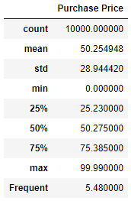
Imputing the data
Since dataset provided does not have any NULL (NaN) values, errors are induced by randomly removing 10% of the ‘Purchase Price’ column data out imputation techniques and its impact
Imputation methods explored:
Replacing with Mean value
Replace with Median value
Replace with a random number from a specified range of values
Replace with a constant value
Use backward and forward fill
Multiple techniques described above provide outcome closer to cleaner data. Amongst the approaches The Mean, Fill and Constant seem to be constantly giving good results w.r.t. original clean data
Backward and Forward fill
Original data
Mean value
Median value
Random value
Constant value

Slide 6
Identify 5 key questions to be answered
Find relationship between Job designation and purchase amount?
How does purchase value depend on the Internet Browser used and Job (Profession) of the purchaser?
What are the patterns, if any, on the purchases based on Location (State) and time of purchase (AM or PM)?
How does purchase depend on ‘CC’ provider and time of purchase ‘AM or PM’?
What are top 5 of Location(State)?

Slide 7
Exploring & Analyzing the data
Answers to the 5 identified questions

Slide 8
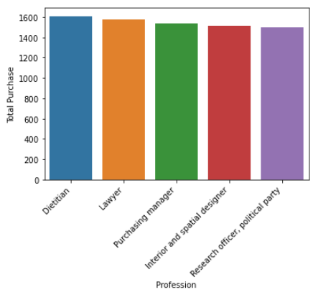
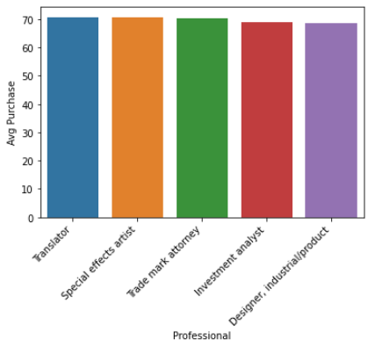
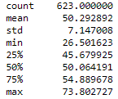
Question (i)
Find relationship between Job designation and purchase amount
There are 623 unique Job groups making 10000 purchases
Distribution of average purchase for each Job group is distributed normally, with the peak at ~50
25% of the groups have average purchase value > 54.88
‘Dietitian’ Job group has the highest total purchase value (~1600)
Average purchase value of ‘Translator’ is the highest at 73.8
Avg. purchase value

Slide 9
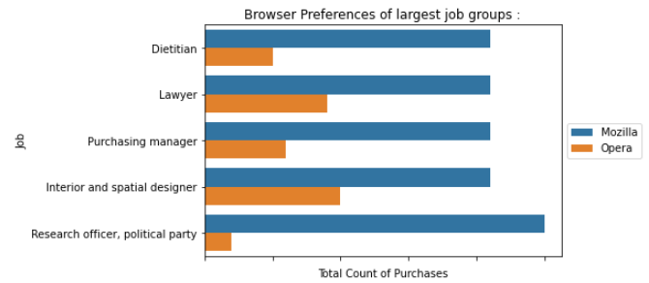
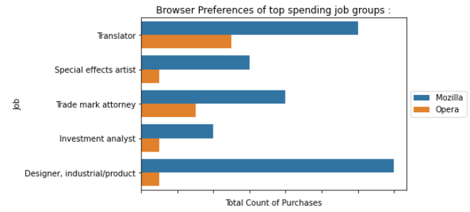
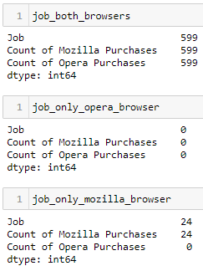
Question (ii)
How does purchase value depend on the Internet Browser used and Job (Profession) of the purchaser?
2 Internet Browsers and 623 different Jobs are present in the data set provided
Distribution of purchase values for the respective browsers are not very different from each other – median values are almost identical at ~50
Top 5 purchasing Jobs (by count and value) have preferred using ‘Mozilla’
Average purchase value per Job for both the browsers is at ~50
Every Job group has preferred Mozilla over Opera for the purchases with respect to count, with some 24 job groups only using Mozilla, and ones using both also have a greater preference for Mozilla
Fig. 1

Slide 10
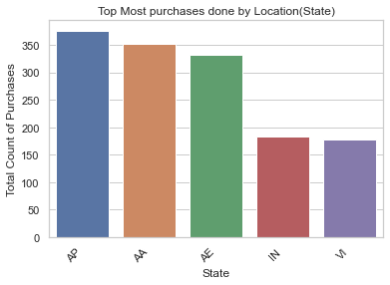
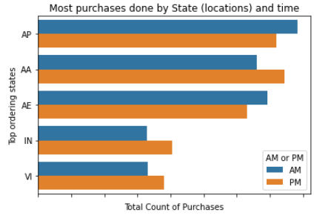
Question (iii)
What are the patterns, if any, on the purchases based on Location (State) and time of purchase (AM or PM)?
Out of the 61 states ‘AP’ has the most number of purchases. However, ‘AP’ is the highest of the lot only for ‘AM’ purchase count
For ‘PM’ purchase count ‘AA’ has the most purchases

Slide 11
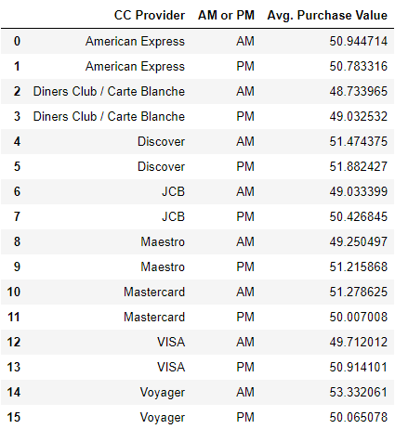
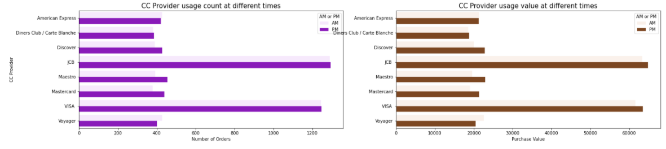
Question (iv)
How does purchase value depend on ‘CC provider’ and time of purchase ‘AM or PM’?
‘JCB’ and ‘VISA’ have seen the most count and overall value of purchases (Fig. 1 and 2)
Average purchase values range between 48 and 53, with ‘Voyeger’ AM purchases being the highest at ~53.3.
The lowest purchase value is that of ‘Diner’s Club’ at 48.7
The median of purchase price of all the 8 CC Providers, is very close to the 50 across both purchase periods
Fig. 1
Fig. 2

Slide 12
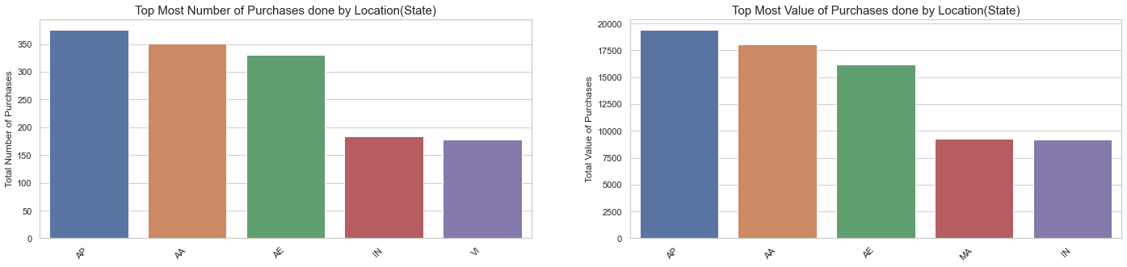
Question (v)
What are top 5 of Location (State)?
AP state has the highest count and value of purchases from the data set, closely followed by AA
Difference among the top 3 states both in count and values is within ~50 count and ~2500 value, which is smaller compared to the 4th and 5th ones
‘AP’ is almost twice that of the 4th or 5th state both on count and purchase value

Slide 13
Learnings & Conclusions
There are NO null values in the data provided
Imputation techniques are very critical, and will be generally needed. We have explored various techniques, after introducing errors in the data to understand the impact of each technique.
Extracting features from the field existing in the data (like ‘Browser’, ‘Location’, etc…) brings out some interesting insights from the data
Scatter plots are not very insightful given that there is only one numerical data set present in the data set
Further Scope for Improvement:
Grouping the purchases based on further grouping field like ‘Job’ might provided more in depth insights
Create more statistical indicators of the numerical variables like ‘Browser Count Ratio’ (Mozilla vs. Opera) could very much help in classifying purchases

Slide 14
Thank You!
Project Team
Links:
Related article published on Medium.com
PRAVEEN MANOHAR G
RAHUL A
RAJESH RAMACHANDER
RANJITH GNANA SUTHAKAR ALPHONSE RAJ
YASHASWI GURUMURTHY
Data Science: Data Cleansing And Visualization For Beginners Using Python
https://medium.com/@ramachander.rajesh/data-science-data-cleansing-and-visualization-for-beginners-using-python-3f55323768f1
Github link to codebase
https://github.com/RajeshRamachander/ecom/blob/master/ecom_eda.ipynb.

